Slide 1
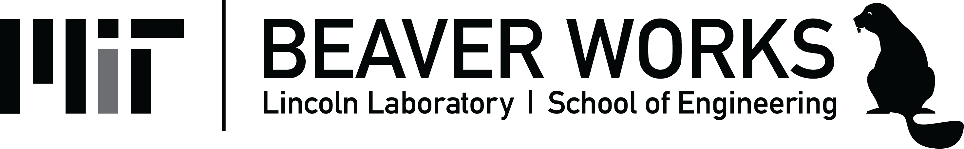
Lab 2
Color Images
This lecture is part of the RACECAR-MN introductory robotics course. You can visit the course webpage at mitll-racecar-mn.readthedocs.io.

Slide 2
Objectives
Main Objective: Identify objects in a color image based on color
Learning Objectives
Learn how to use Jupyter notebooks
Use OpenCV functions to build image processing functions
Understand and implement proportional control

Slide 3
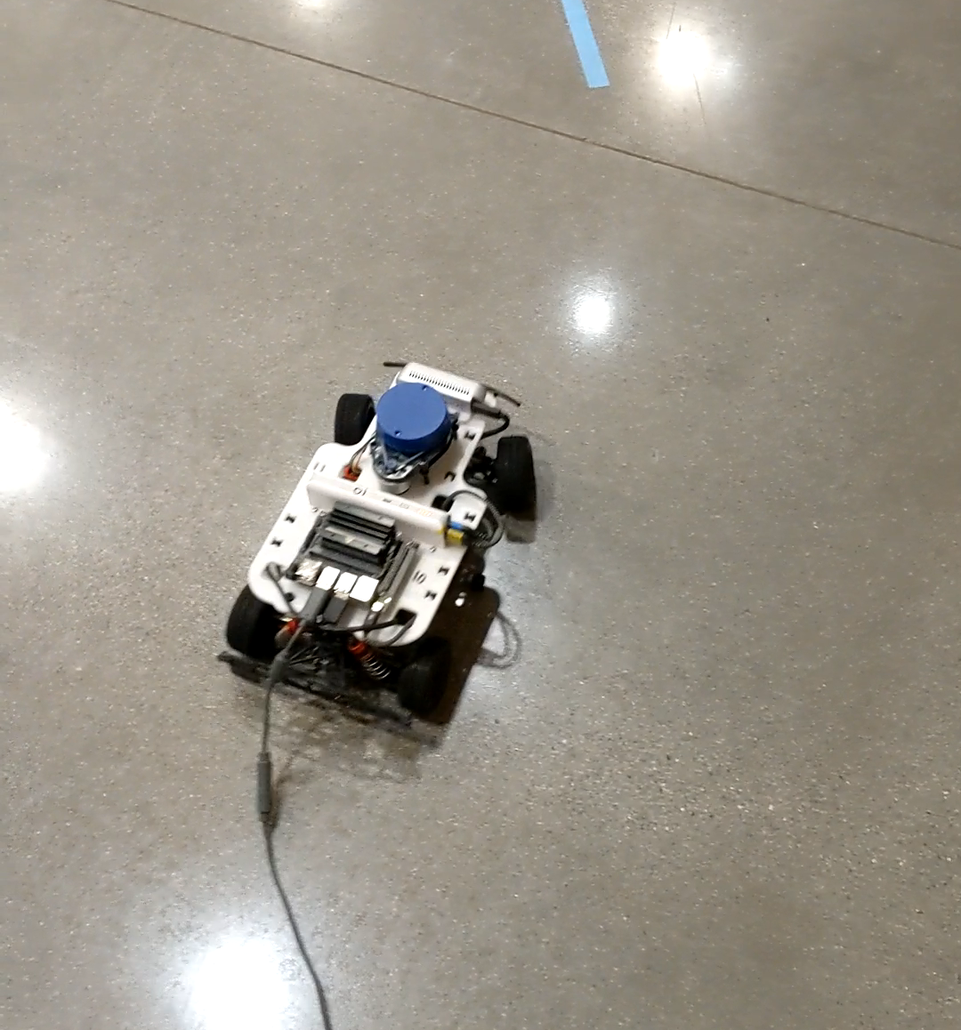
Lab 2 Demo

Slide 4
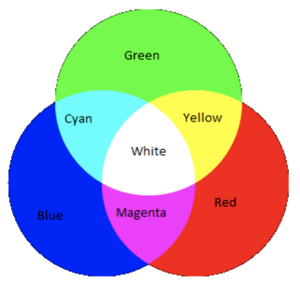
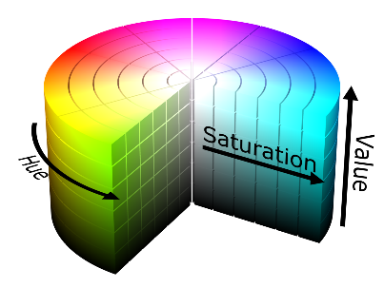
Color Space
Color models map input values to colors
Color space is a range of colors a color model covers
BGR models use measurements of blue, green, red
BGR
HSV

Slide 5

HSV
Hue: the base color
Range: 0°- 180°
Saturation: inverse the amount of white
Range: 0 - 255
Value: inverse the amount of black
Range: 0 - 255
H: 90°
S: 194
V: 207

Slide 6
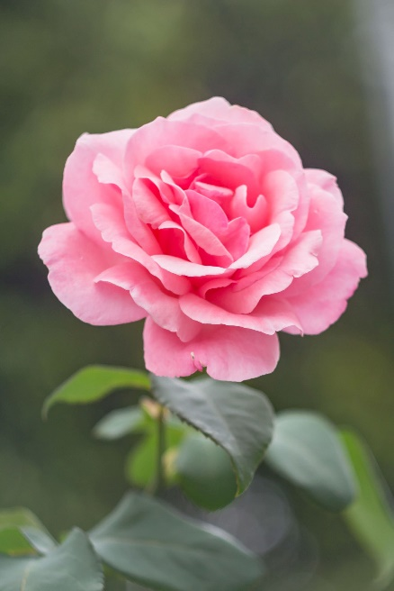
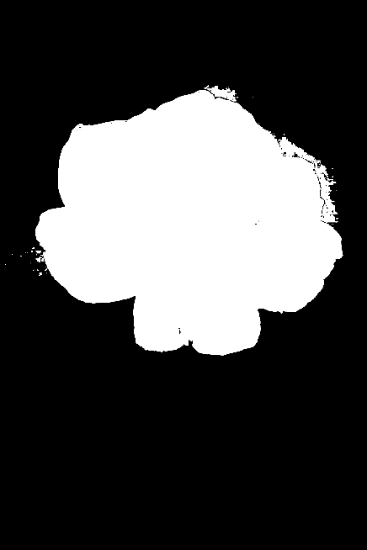
OpenCV
Using a color threshold, we can make masks from images
BLACK out the part of the image you want to remain hidden
WHITE out the part of the image you want to be seen

Slide 7
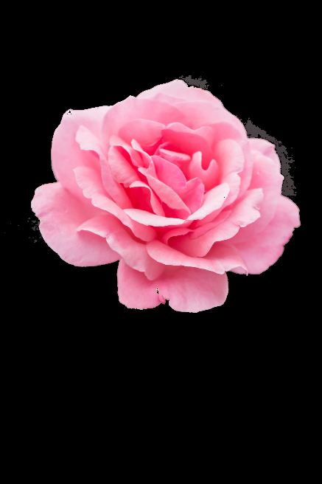
Color Masking
Combine the color image with the black and white mask to make a color mask

Slide 8
Color Masking
White mask
Full color
Black mask
No color
Color masks can be made with any black and white image.

Slide 9
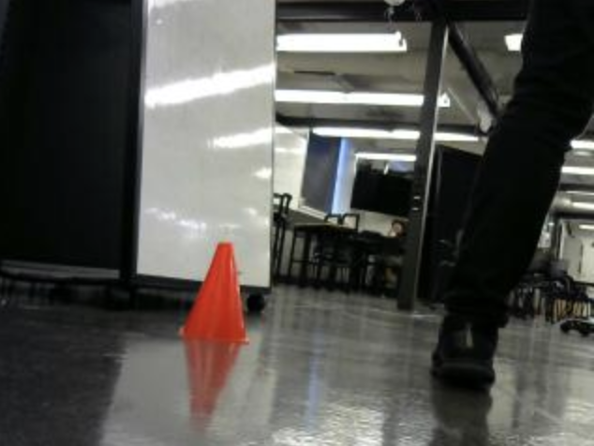
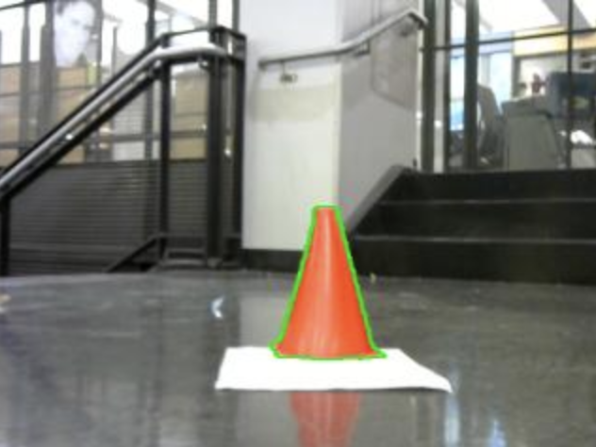
Contour Drawing
With color masks, we can identify objects and create contour drawings

Slide 10

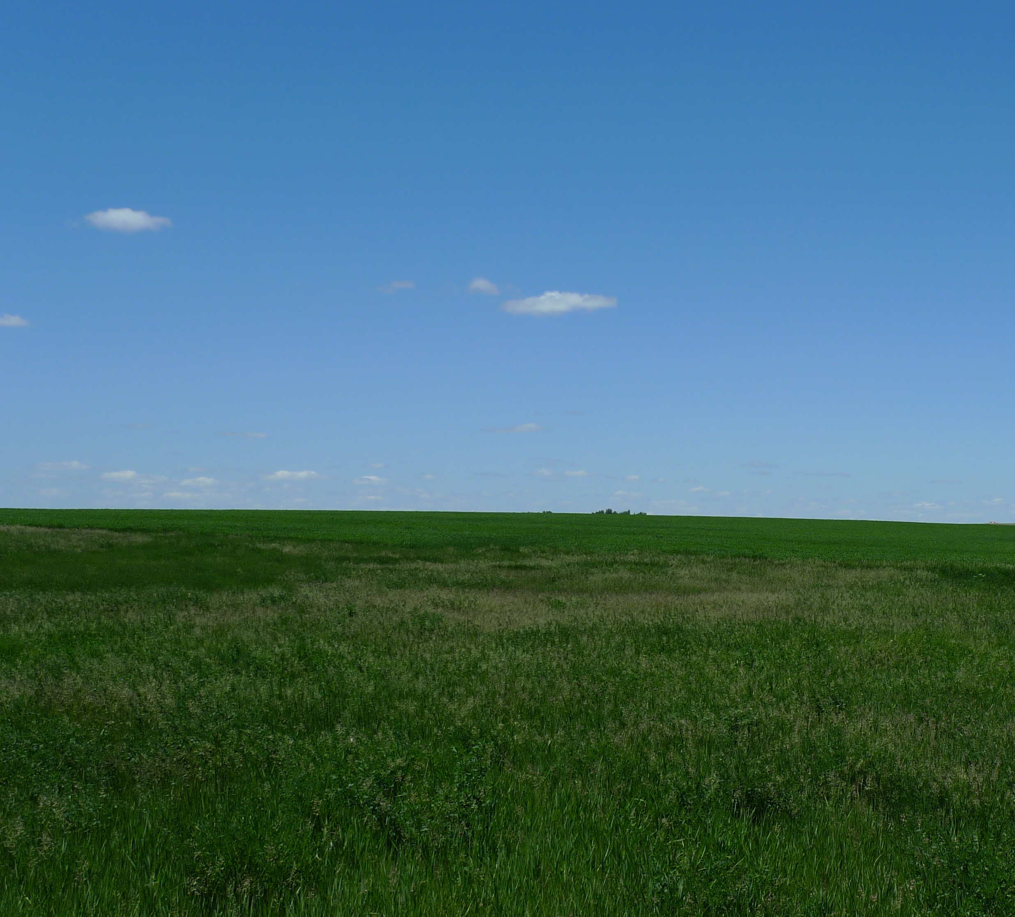
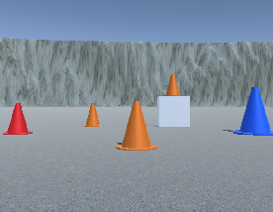
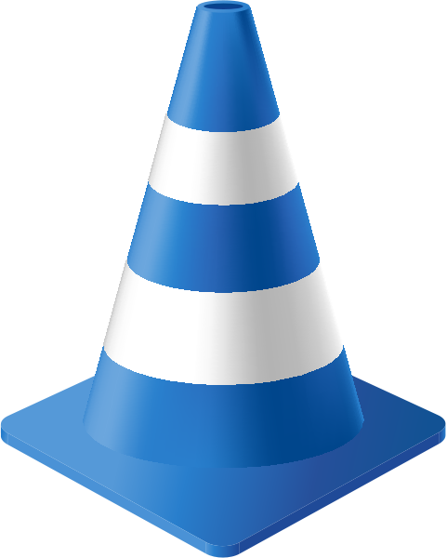
Group activity
Common Issues
What issues might we have with these images and how would we address them?

Slide 11
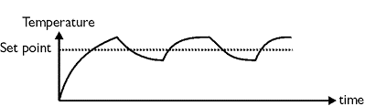
Bang-Bang Control
Bang-Bang control uses feedback from the environment to switch between two states. This method of control oscillates around the set point in the acceptable bounds.

Slide 12
Proportional Control
Proportional control uses feedback from the environment to proportionally set output values. Input is linearly proportional to output
Input
Output

Slide 13
Camera Module
Retrieves color and depth images from the camera
Public Interface
get_color_image()
get_width()
get_height()
get_depth_image() (we'll use this next time)
Notes:
https://mitll-racecar.readthedocs.io/en/latest/camera.html

Slide 14
Display Module
Displays data and images to the screen
Simulation: Creates a window on your computer
RACECAR: creates a window on the mini-monitor
Public Interface
show_color_image()
show_depth_image() (we'll use this later)
show_lidar() (we'll use this later)
Notes:
https://mitll-racecar.readthedocs.io/en/latest/display.html

Slide 15
Example 1
Group activity
image = rc.camera.get_color_image()
for r in range(0, rc.camera.get_height()):
for c in range(0, rc.camera.get_width()):
foo = (image[r][c][0] + image[r][c][1] + image[r][c][2]) // 3
image[r][c][0] = foo
image[r][c][1] = foo
image[r][c][2] = foo
rc.display.show_color_image(image)

Slide 16
Example 2
Group activity
image = rc.camera.get_color_image()
foo = 0
bar = (0, 0)
for r in range(0, rc.camera.get_height()):
for c in range(0, rc.camera.get_width()):
if image[r][c][0] > foo:
foo = image[r][c][0]
bar = (r, c)
print(bar)

Slide 17
Lab 2 Objectives
Jupyter Notebook: Write helper functions which use masks/contouring to identify objects based on color
Lab 2A: Implement line following
Lab 2B: Cone parking

Slide 18
racecar_utils Library
Helper functions to process inputs/outputs of racecar_core
You will write everything in racecar_utils during the Jupyter notebook activates throughout the course
Documentation
Implementation

Slide 19
Jupyter Notebooks
Example: lab2.ipynb

